Slide 1
DOING DATA
SCIENCE
Beers and Breweries Project
Onyeka Emmanuel and Jobin Joseph
https://youtu.be/HCKqXezsHdQ

Slide 2
Exploratory Data Analysis of Beers
WHY?
Agenda
Explain the beers data set & brewery data set
Analysis of breweries by state
Combining of both datasets to make inferences
Looking into the median Alcohol content of Beers by state
Exploring the trends in Alcohol Content of Beers in the USA
Is there any relationship between bitterness of the a beer and its alcohol content ?
KNN classifier model
Bottle sizes in US
Conclusion
Notes:
The purpose is to share inferences that we made from our analysis with data provided that will hopefully guide executive decisions in the future

Slide 3
Beers & Breweries Data set
We received from the company two data sets .
Beer dataset included a list of different beers their beer ID , Brewery ID associated with it and Information about It’s style , Alcohol by Volume (ABV), and International Bitterness Units (IBC).
Breweries dataset included a list of names of breweries , their Brew IDs, and location.
Notes:
We can explain location includes state and city of breweries

Slide 4
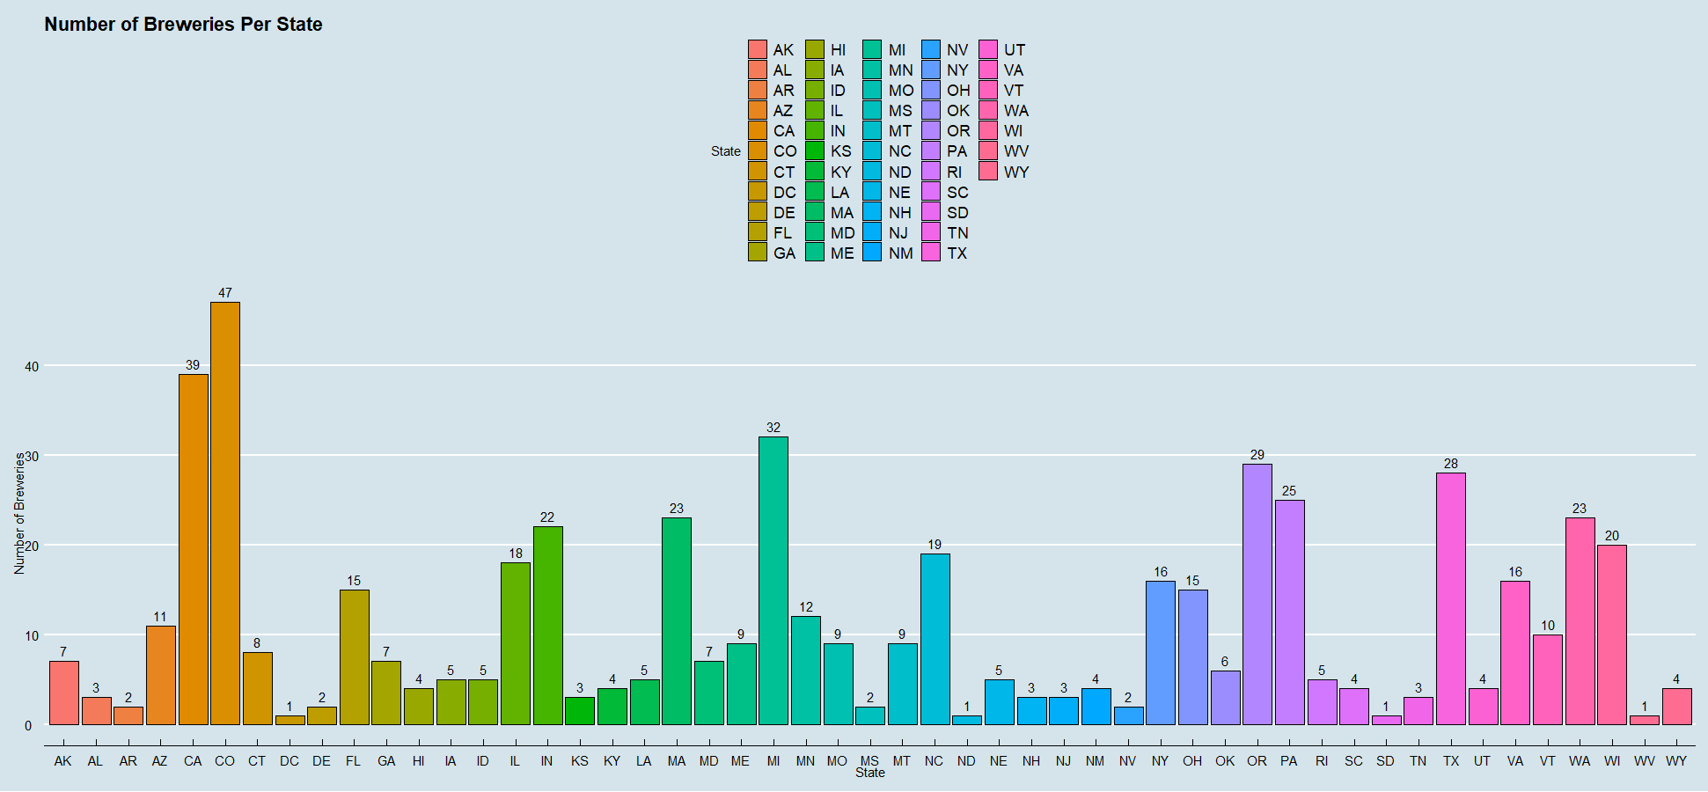
Analysis of Breweries by state
Notes:
Using this graph we can see what states have higher and lower Number of breweries per state and this graph is good because it is quantifiable

Slide 5
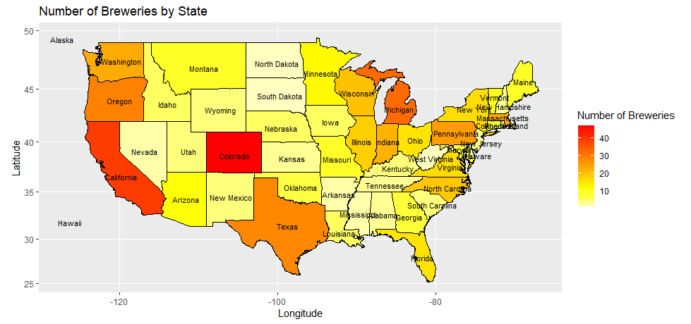
Heat Map of Breweries by state
Notes:
Explain the Heat Map darker = more
We have more breweries in Colorado, California, Oregon, Michigan, Texas

Slide 6
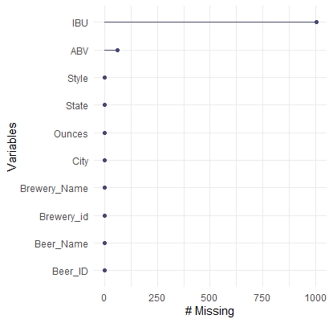
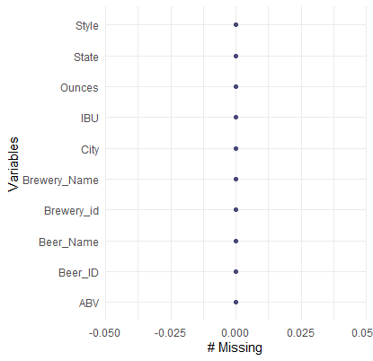
Before & After
Notes:
These graphs show that we took out the missing values to tidy our data.
Using the common factor of Brewery ID we were able to link both Datasets by linking the beers with their corresponding Brewery

Slide 7
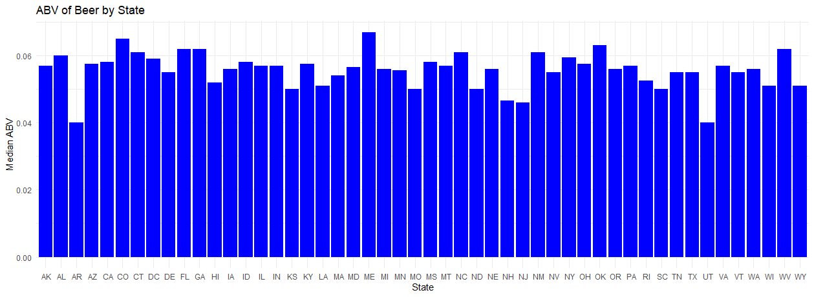
Looking into the median Alcohol content of Beers by state

Slide 8
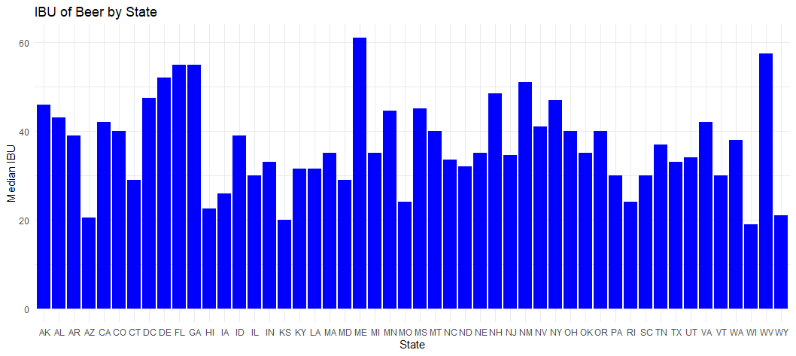
Looking into the median IBU of Beers by state

Slide 9
Maximum ABV and IBU
The state with the highest Alcoholic Beverage by Volume (ABV) beer is Colorado .
The beer is called Lee Hill Series Vol. 5 - Belgian Style Quadrupel Ale having a ABV of 0.128
The state with the highest International Bitterness Unit (IBU) beer is Oregon.
The beer is called Bitter Bitch Imperial IPA and has an IBU of 138
Notes:
Note: Belgian Style Quadrapel Ale is not in the cleaned dataset.

Slide 10
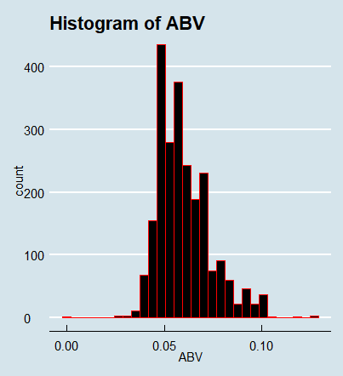
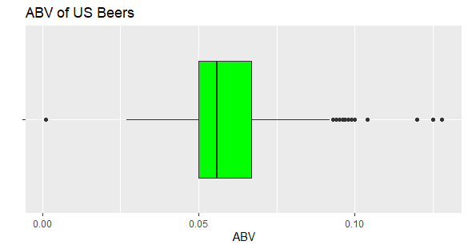
Exploring the trends in Alcohol Content of Beers in the USA
The Summary of ABV in US Beers
Minimum | 1st Qu. | Median | Mean | 3rd Qu. | Max
0.0010 | 0.0500 | 0.0560 | 0.0598 | 0.0670 | 0.1280
Notes:
So we can see from the data that the median of the APV in beers in the US is around 0.056 and the minimum is 0.001 and the maximum is around 0.128

Slide 11
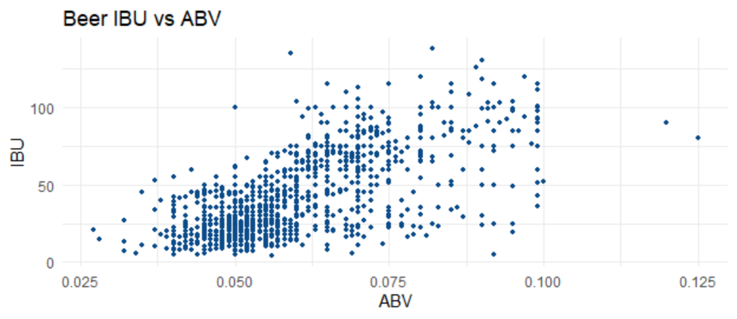
Is there any relationship between bitterness of the a beer and its alcohol content ?

Slide 12
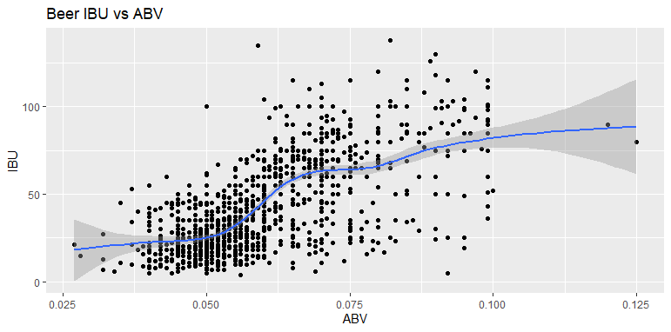
Is there any relationship between bitterness of the a beer and its alcohol content ?
Notes:
There is a positive correlation between IBU and ABV. The correlation is strongest between the two when ABV is between 0.05 and 0.075

Slide 13
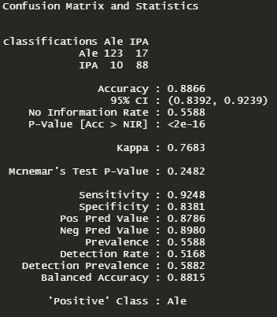
IPA vs Other Ales
We can see a relationship between IPA and other ales.
Using the knn classifier model we are able to predict whether a beer is a IPA or other Ale with 88.7% accuracy .

Slide 14
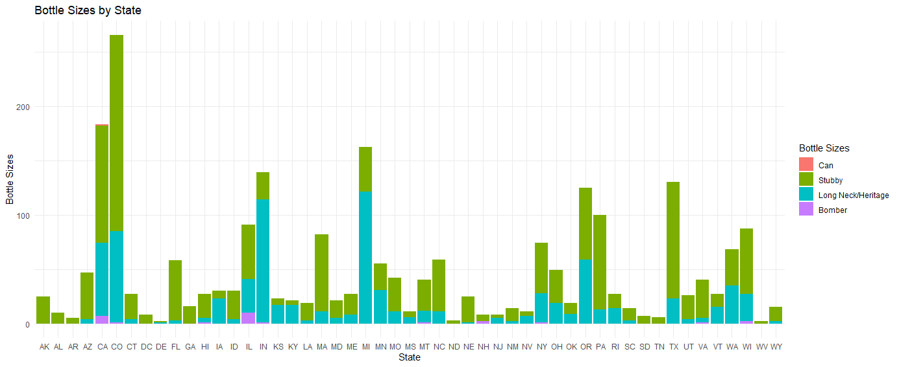
Bottles sizes
We can get some idea about what size bottles is being sold in each state, and be able to guide future beer launches and what size to target in what locations.
Notes:
We grouped each beer into five categories based on their ounces for further analysis and plotted a bar chart. Looking at the bar chart we can see that the most common beer bottle size in most states is the Stubby which ranges from 11 to 12 ounces. Some states such as Indiana and Michigan seem to have more of the Long Neck/Heritage beer size which ranges from 12 to 22 ounces. In every state the least available beer bottle size seemed to be the Bomber which ranges from 22 to 32 ounces. This information can help guide future beer launches and what sizes to prioritize in what locations.

Slide 15
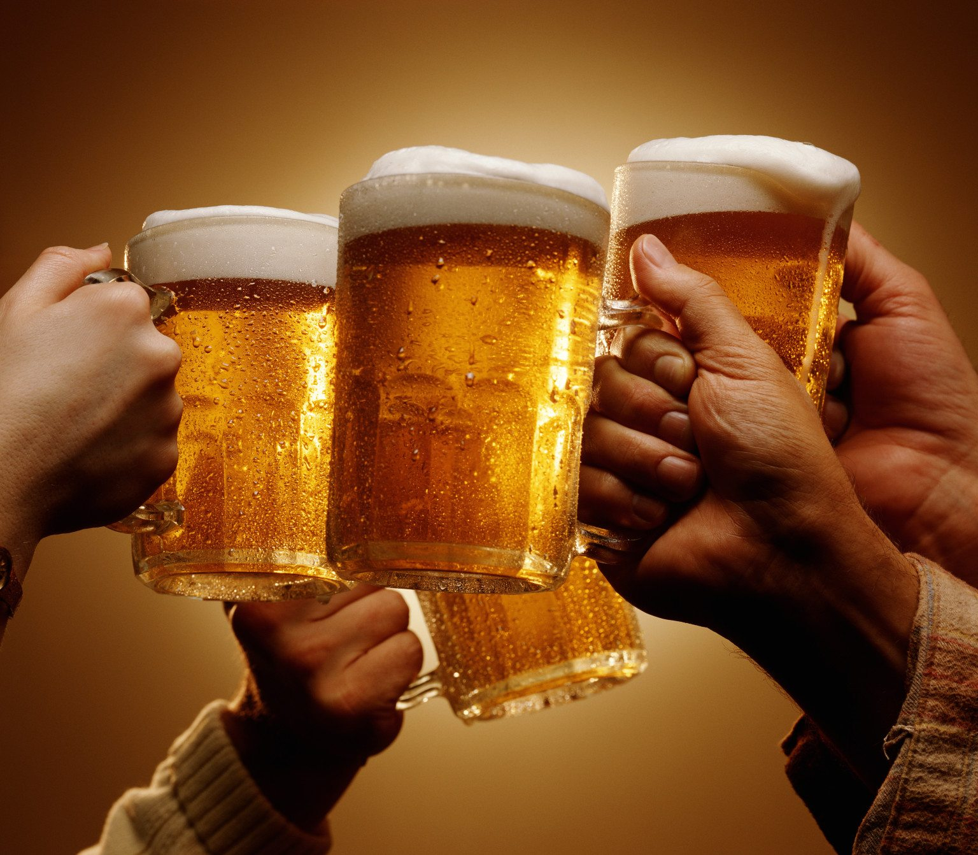
Closing Statement
We were able to conduct analysis from multiple different angles , and make inferences based on the datasets that were provided. We hope that this will fuel data driven decisions on future beer launches and beers that might need to be refreshed.

Slide 16
Thank You !

